Slide 1
Digital Portfolio
STUDENT NAME: D.GOKULNATH
REGISTER NO AND NMID: 222404556/
DEPARTMENT: BSC.SOFTWARE APPLICATION
COLLEGE: COLLEGE/ UNIVERSITY:A.M.JAIN COLLEGE

Slide 2
PROJECT TITLE
DIGITAL
PORTFOLIO

Slide 3


AGENDA
Problem Statement
Project Overview
End Users
Tools and Technologies
Portfolio design and Layout
Features and Functionality
Results and Screenshots
Conclusion
Github Link
3/21/2024 Annual Review

Slide 4

PROBLEM STATEMENT 1)BUILDING THE STRUCTURE 2)GIVING PERFECT COLORS 3)INSERTING PICTURES 4)MAKING SCROLLING SMOOTH 5)MAKING IT RESPONSIVE

Slide 5

PROJECT OVERVIEW A Digital portfolio fully attached about my skills in the software world and also it holds my project I have linked my github , linkedin , twitter profile

Slide 6

WHO ARE THE END USERS? The end users are.. The companies I go for interview my online clients

Slide 7

TOOLS AND TECHNIQUES HTML CSS JAVASCRIPT

Slide 8
POTFOLIO DESIGN AND LAYOUT
It as a maginificent Purple blended violet colors and it has my profile photo , My name in the Starting after scrolling down you can find my projects , and what Skills do i have and lastly you got a information box to fill up your details and get in touch with me...
- Thank you!!
8

Slide 9
FEATURES AND FUNCTIONALITY Display My Essential Details Scrolls Smootly it has a Arrow button in the left to scroll up from down

Slide 10
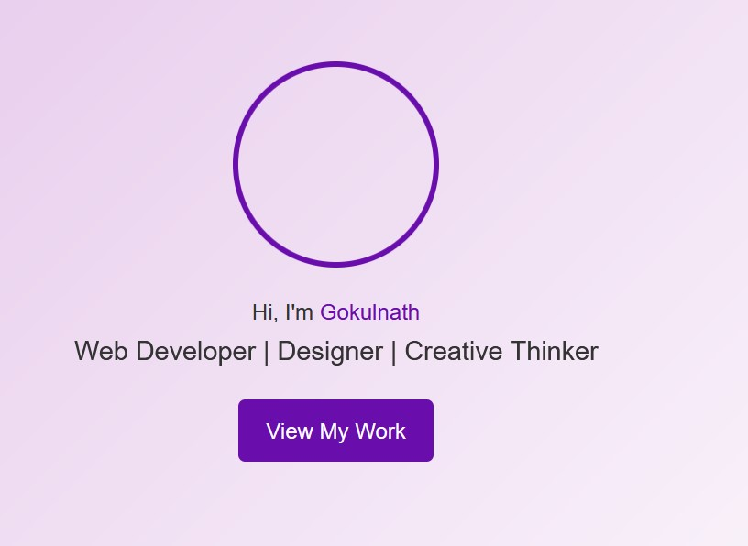
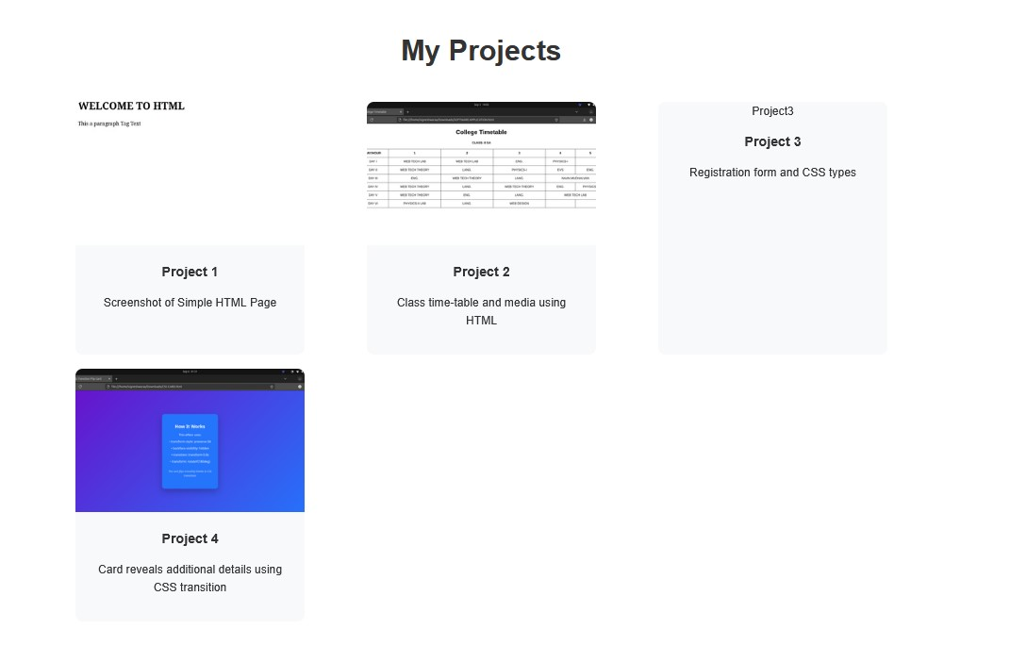

RESULTS AND SCREENSHOTS
3/21/2024 Annual Review
10

Slide 11
CONCLUSION
I have created this Portfolio with my Hardwork and
consistency
GITHUB LINK:https://24j026-gokul.github.io/TNSDC-FWD-DigitalPortfolio/
PORTFOLIO: https://github.com/24j026-gokul/TNSDC-FWD-DigitalPortfolio.git
11

